Slide 1
Intro. to Study Designs & Observational Descriptive study design
Themba Ginindza, PhD, MSc, MPH
Professor/Epidemiologist/MLCCP Lead PI/CCPAC PI
Director: Cancer & Infectious Diseases Epidemiology Research Unit (CIDERU)
Department of Public Health Medicine, University of KwaZulu-Natal
Tel: +27 31 260 4214 | Mob:+27 719 1111 79
Email: Ginindza@ukzn.ac.za

Slide 2


Slide 3
Outline
Introduction
Elements of study designs
Selection of research design
Validity
Study designs
Types of Epidemiological study designs
Analysis
Strength & Weakness
3

Slide 4
“It is much more important to know what sort of a patient has a disease, than what sort of disease a patient has”
(William Osler)

Slide 5
Introduction
Research approach & Research/study design: terms frequently used interchangeably yet different
Research/study design: is a broader plan to conduct a study.
Research approach is an important element of the research design, which governs it.
4

Slide 6
The Approach
It involves the description of the plan to investigate the Research Problem under study in a structured (quantitative), unstructured (qualitative) or a combination of the 2 approaches (quantitative-qualitative integrated approach)
Approach helps to decide about the presence or absence as well as manipulation & control over variables
The approach of research study depends on several factors but primarily on the nature of Research Problem under study
At this stage of the research study, conceptual Framework may or may not be incorporated
5

Slide 7
Study design
The FRAMEWORK/GUIDE used for planning, implementation & analysis of a study.
A SYSTEMATIC PLAN of what is be done, how it will be done, & how analyses will be done.
Is the MASTER PLAN specifying the methods and procedures for collecting and analysing data
Defined as a BLUE PRINT to conduct a research study, which involves the descriptive of research approach, study setting, sampling size determination, sampling technique, tools and method of data collection and analysis to answer specific research questions or for Hypothesis testing.
A PLAN of how, when & where data are obtained and analysed.
6

Slide 8
Elements of Study design
Population, sample size & Sampling technique:
Study design also provide the investigator/researcher with directions about population, sample size & sampling technique, to be used for the research study.
Example: in a Quantitative study design, an investigator gets a directive that the population will be pregnant women attending ANC (group) and the study will include a sample size of x selected through systematic sampling technique.
7

Slide 9
Elements of Study design
Time, Place & source Data collection:
Time: specifying days, months, years of study
Place: location (Study settings): Study Area vs Settings
The sources of the requisite data are the other important constituents essential to ensure effective planning to conduct a research study
8

Slide 10
Elements of Study design
Tools and methods of data collection:
It involves the description of different tools and methods of data collection
Example:
Questionnaires
Interviews
Direct observation
Any other method that suit the particular approach of research as well as nature of the phenomenon under study.
9

Slide 11
Elements of Study design
Data Analysis Methods:
Data-driven and relies on a systematic and unbiased approach to collect, analyze, and interpret data
Research design MUST also include the description of the methods of data analysis – either quantitative or qualitative data analysis techniques.
That helps the researcher/investigator to collect relevant data, which later can be analysed as per research design plan.
Without a formal plan of data analysis an investigator may collect irrelevant data, which can later become difficult to analyse (GIGO).
10

Slide 12
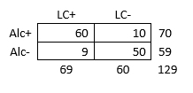
Data Analysis (Guided by Statistical Analysis Plan)
A. Univariable
Descriptive
Describes the study population (generalizability); compare intended vs actual population
Precedes bivariable and multivariable data analyses
B. Bivariable
Simple, unadjusted associations between two variables
2x2, 2xX, Chi-Square, T-tests
Check test assumptions; Expected and Low Values
Avoid bivariable regression models until the end
Multiple testing (a-priori analyses otherwise report as exploratory)
Alcohol LC
11

Slide 13
Data Analysis (Guided by Statistical Analysis Plan)
C. Multivariable
Y_{ii} = α_{i} + E₁β₁ + E₂β₂ + E₃β₃ + E₄β₄ + E₅β₅ (Risk Factor)
Y_{ii} = α_{i} + E₁β₁ + C₁β₂ + C₂β₃ + C₃β₄ + E₁*C₂β₅ (Hypothesis Driven)
Exposure, Confounders, Mediators, Effect Measure Modifiers
Should know what the results will be even before running models
Model assumptions – Confounder Criteria – Confounding - Modification
Study type & measures of association
Sensitivity analysis
Model fitness
x Smoking
Alcohol LC
12

Slide 14
Data Analysis Methods
Draws on methods from various scientific fields such as biostatistics, informatics, biology, economics, social and behavioral sciences.
Considers the role of genetics/biology, individual behavior, community, socio-economic, cultural (Anthropology), environmental and historical factors on health.
Biostatics
Biology
Economics
Sociology
Ethnography
Informatics
Epidemiology
13

Slide 15
DECISION: SELECTION OF RESEARCH DESIGN
14

Slide 16
Epidemiology In action
Def. Epidemiology: The study of the distribution and determinants of health-related states or events in specified populations, and the application of this study to the control of health problems.
Study designs are plans and procedures for research that extend the decisions from broad assumptions to detailed methods of data collections and analysis.
Investigators must select the most appropriate design in order to achieve the aims and objectives of the study.
15

Slide 17
FIRST STEPS
The selection of study design largely depends on the:
Nature of the research problem
What is the purpose of your investigation?
Health challenges you observe; review of the literature
Availability of Resources (Time, Cost, Materials, expertise of the investigator (4Ms))
Subjects/participants accessibility
Research ethics
Do you have a validated instrument to collect the data?
Have the validated instrument been piloted and training provided?
16

Slide 18
Factors affecting selection of study design
Nature of Research Problem
Is the most important factor, which helps the investigator to decide about the selection of study design.
Based on the nature of the research problem, investigator deicide whether it should be investigated through experimental or non-experimental.
Purpose of the study
Study may be conducted for the purpose of prediction, descriptive, exploration, or correlation of the research variables.
Therefore, the purpose helps the investigator to choose the suitable study design.
17

Slide 19
Count……
Investigator’s expertise
Selection of study design is largely influenced by the investigator’s Knowledge & experience, because they avoid using those designs wherein they lack confidence, relevant expertise
Investigator’s interest and motivation
Interest and motivation levels help investigator.
Therefore, the purpose helps the investigator to choose the suitable study design(s).
Most motivated investigators always analyse most aspects of study design before selected one or combination.
NB: Casual investigators may choose study design (s) that may lead to Failure
18

Slide 20
Count……
Research Ethics and Principles
The incorporation and application of ethical considerations and principles in study design are vital.
This includes moral obligations such as;
Respect & Rights for study subjects/participants.
Informed consent.
Potential risks or discomfort on participants: Biological risks, Psychological risks, Social Risks, Legal risks, Financial risks, Other risks (BREC-Form).
Selection is significantly influenced by the ethics of the study design.
e.g. An investigator may want to conduct a study through a certain experimental approach, but problems of ethical approval may stop the investigator to carry on with the study and investigator may opt or settle for another available possible deign.
19

Slide 21
Count……
Study population/participants
Sample size (number) and availability of the participants does influence the selection of the research design. If only few subjects are involved, an in-depth qualitative investigator may opt for Qualitative design.
Resources : (4Ms)
NO investigator can conduct research without resources
Money, equiments, facilities & support from colleagues
However, some studies may require a lot of resources as compared to others. Therefore, the selection of a study design may be affected by the availability of resources.
20

Slide 22
Count……
Time
Time is also a major deciding factors for the selection of study design.
Ex., an Investigator needs more time to conduct longitudinal/cohort studies, while Cross-sectional studies can be conducted in shorter time.
Users of the findings
Study design also use various methods of data collection and data analysis.
Therefore, while choosing a study design, investigator Must ensure that study design is as appropriate for the users of the study findings as possible, so that that maximum advantage of the results can be obtained.
21

Slide 23
Count……
Possible Control on Extraneous variables
An efficient design can maximize results, decrease errors, and control pre-existing or impaired conditions that may affect study outcome.
The maximize efforts of the investigator should maximize control.
Therefore, possible control over the extraneous variables may affect the selection of a study design.
Ex., An investigator wants to conduct a study through TRUE- Experimental design but because of inability to control selected extraneous variables, other similar design has to be opted for, such as quasi-experimental or pre-experimental design
22

Slide 24
Validity of study design
Two important CRITERIA for evaluating the credibility & dependability of the research results:
Internal Validity
External Validity
23

Slide 25
Internal Validity
Validates whether the independent variables actually made a difference
Internal validity refers to the extent to which it is possible to make an INFERENCE that the independent variable is TRULY influencing the dependent variable (Campbell et al, 1963)
In the internal validity, the independent variable is responsible for variation in dependent variable.
Internal Validity demands a tighter control over study to maximize the effectiveness of the results
24

Slide 26
Count……
Internal validity is helpful in making the inference that the independent variable influences the dependent variable
SIX major extraneous variables have been identifies which can jeopardize the internal validity (knows as Threats to internal validity):
History
Maturation of subjects (age)
Testing
Instrumentation changes
Mortality
Selection Bias
25

Slide 27
Mortality
The threats of History occurs when some event beside the experimental treatment occurs during the course of the study, and this events even influences dependent variables.
E.g., you are conducting a health education programme on the importance of Cervical cancer Screening (CCS), while recently a Public figure is diagnosed to be suffering from cervical cancer.
It catches media attention: Medical experts are interviewed, & importance CCS is supported.
All major TV channels and newspapers starts reporting on the importance of CCS
Results: CCS activity has improved, you as an Investigator may be able to conclude if the change in behaviour is due to your intervention (Health education programme) or it is due to the diagnosed of affliction of the public figure and subsequent media coverage.
26

Slide 28
Maturation of subjects
When a research (e.g. experimental research) is carried on for along period of time over a group of subjects, they may be changes in the subjects in different ways, e.g. in children there is increase in weight, height, etc.
Example.; An investigator is interested in assessing the effect of particular nutritional protocol on the weight and height of the malnourished children
If this experiment is conducted for a very long period, it is difficult to make out whether the effect on weight and height is due to maturation or nutritional protocol
27

Slide 29
Testing
It refers to the effect of taking a pre-test of subjects’ performance post-test.
The effect of taking a pre-test may sensitize an individual and improve the score of the post-test.
Individuals generally score higher when they take test a 2nd time regardless of the treatment
28

Slide 30
Instrumentation change
Instrumentation is a threat that related to Measurement.
This bias reflects changes in measuring instruments or methods of measurements between two points of data collection.
Instruments like weighing scale, tape measure, thermometer, sphygmomanometer, etc. Should be checked for their accuracy at regular intervals, & same instruments should be used throughout the study to minimize the instrument-related error of the internal validity.
29

Slide 31
Mortality and Mobility
Mortality can lead to loss or dropout study participants during the study period.
If the participants who remain in the study or join later are not similar to those who dropped out, the results could be affected.
Ex., In Cohort Study: some participants who participated in the 1st follow-up might not be available in the next follow-up.
30

Slide 32
Selection Bias
If the participants are not selected randomly for participation in groups, then there is a possibility that the groups which will be compared may not be equivalent (not representative of the population intended to be analysed).
31

Slide 33
External Validity
It refers to the extent to which the results can be generalized to the larger population (GENERALIZABILITY OF RESULTS).
External validity researches under what conditions & in which type of participants the same results can be expected to be replicated, or whether the same intervention can be applicable in another setting & with different participants.
It explores the generalization beyond specific experiment, to check if the results come out to be the same with other settings or with other participants/population.
32

Slide 34
Factors affecting External Validity
Hawthorne effect
Subject may behave in a particular manner because they are aware that they are being observed.
Participants have the knowledge that they are involved in a study, thus affecting the result.
Experimental effect
It’s a threat to study results when investigator’s characteristics, mannerisms, behaviour may influence subject behaviour.
E.g.: investigator characteristics: facial expressions, clothes, age, gender, body built.
Thus, the way researcher dresses up or his or her gender can influence the way in which respondents answer research questions
33
Notes:
Hawthorne Effect is when subjects of an experimental study attempt to change or improve their behavior simply because it is being evaluated or studied

Slide 35
Factors affecting External Validity
Reactive effect of pre-test
It occurs when participants have been sensitized to the treatment because of taking pre-test.
Participant might not respond to the treatment in the manner they finally do if they had not received the pre-test.
E.g.:, An Investigator wants to conduct a study to assess the effect of a health education programme on the awareness of HIV/AIDS among youth.
Instead, he/she conduct pre-test to collect baseline data before the intervention.
This pre-test may sensitize the participants to learn more about HIV/AIDS irrespective of health education is provided or not to theme
Novelty Effect
When treatment is new, investigators & participants might behave in different ways.
They may be enthusiastic about new methods of new methods of doing things.
Once treatment is more familiar & as the novelty wears off, results might be different.
34
Notes:
Hawthorne Effect is when subjects of an experimental study attempt to change or improve their behavior simply because it is being evaluated or studied

Slide 36
Factors affecting External Validity
People
E.g., people with specific race, such as whites have high prevalence of coronary artery disease compare to indigenous Africans.
Therefore, a generalization made for whites will not be applicable to indigenous Africans. hence, this is a threat to external validity (limit the generalizability of the findings)
Place
E.g. people living in high altitudes have high haemoglobin (Hb) levels because of the higher altitudes the requirement of oxygen is more, due to which there is more production of red blood cells (RBCs). Therefore, you can’t compare people living in higher altitudes to those in lower altitudes (thus affect generalizability).
Time
If study was carried out of a community in 1995 & then again in 2010, the results of these 2-studies would be different. Therefore, older results cannot be generalized over periods of time as societies & circumstances constantly change.
35

Slide 37
STUDY DESIGNS
Generally research designs are classified into TWO Broad Categories
Qualitative design
Quantitative design *****Epidemiological Study Designs
36

Slide 38
Quantitative/Qualitative
Quantitative research: involves measurement of outcomes using numerical data under standardized conditions
May be used along the continuum of research.
Qualitative research: is concerned with narrative information under less structured conditions that often takes the research context into account
Descriptive and exploratory research.
Purposes: describing conditions, exploring associations, formulating theory, generating hypotheses.
37

Slide 39
Assumptions in Scientific Research
Nature is orderly and regular.
To some extent, events are consistent and predictable.
Events or conditions have one or more causes that can be discovered
This enables establishing cause and effect relationships
38

Slide 40
Properties of scientific method
Systematic
Use of orderly procedures to ensure reliability
Logical sequence is used from problem identification, through data collection, analysis, & interpretation
Empirical
Documentation of objective data through direct observation (or other systematic methods)
Findings are grounded in the objective observation of phenomena rather than the personal bias or subjective belief of the researcher
Control
In order to understand how one phenomenon relates to another, factors are controlled that are not directly related to the variables in question
Investigators have confidence in their research outcomes to the extent that they control extraneous influences.
39

Slide 41
Types of Epidemiological Study Designs
Observational
Experimental
Descriptive
Analytical
Randomized Control Trials (RCT)
Cross-Sectional
Population level (Aggregated)
Quasi-Experiment
Cohort/Longitudinal
Individual Level
Case-Control
Ecological (Group)
41

Slide 42
Observational studies
Descriptive
Analytic
Suggest hypotheses
Resource allocation
Natural history
Test hypotheses
Assess association/causation

Slide 43
Descriptive study/research
Descriptive: investigator attempts to describe a group of individuals on a set of variables or characteristics.
Enables classification and understanding.
Methods: surveys, case study, qualitative, developmental (natural history of something, patterns of growth and change), normative, evaluation.
43

Slide 44
Exploratory study/Research
Investigator examines a problem of interest and explores its dimensions, including how it relates to other factors.
Proven relationships between the problem and other factors can lead to predictive models.
Correlational studies, cohort and case control, secondary analysis, historical research.
44

Slide 45
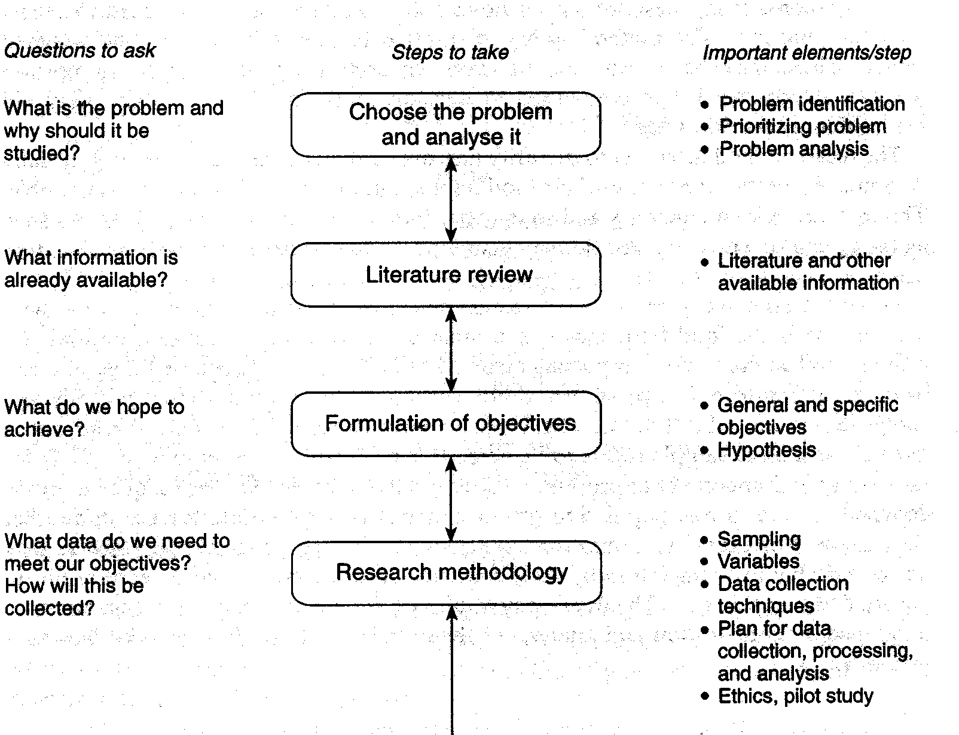
Steps in cross-sectional studies

Slide 46
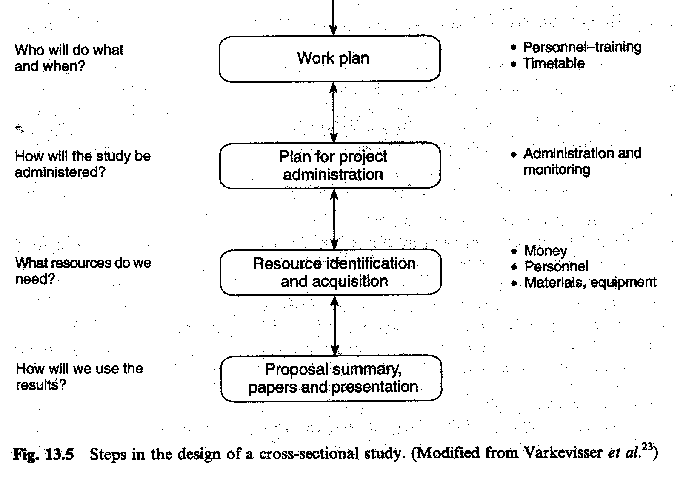
54

Slide 47
Experimental study/Research
Provides a basis for comparing 2 or more conditions.
Controls or accounts for the effects of extraneous factors, providing the highest degree of confidence in the validity of outcomes.
Enables the researcher to draw meaningful conclusions about observed differences.
Types: Randomized controlled trials, single subject designs, sequential clinical trials, evaluation research, quasi-experimental research, meta-analysis.
45

Slide 48
Design options in epidemiologic research
Type of study
Alternate name
Unit of study
Observational studies
Descriptive studies
Analytical studies
Ecological
Correlational
Populations
Cross-sectional
Prevalence
Individuals
Case-Control
Case-Reference
Individuals
Cohort
Follow-up/ Longitudinal
Individuals
Experimental/ intervention Studies
Randomized Controlled Studies
Clinical Trial
Patients
Field Trial
Healthy person
Community Trial
Community intervention studies
Communities

Slide 49
Qualitative Study
Seeks to describe how individuals perceive their own experiences within a social context
Emphasizes in-depth, nuanced understanding of human experience and interactions
Methods include in-depth interviews, direct observations, examining documents, focus groups
Data are often participants’ own words and narrative summaries of observed behavior
83

Slide 50
Qualitative Study
Strengths
Data based on the participants’ own categories of meaning
Useful for studying a limited number of cases in depth or describing complex phenomena
Provides understanding and description of people’s personal experiences of phenomena
Can describe in rich detail phenomena as they are embedded in local contexts
The researcher can study dynamic processes (i.e., document sequential patterns/change)
Weaknesses
Knowledge produced might not generalize to other people or other settings
It is difficult to make quantitative predictions
It might have lower credibility with some administrators and commissioners of programs
Takes more time to collect and analyze the data when compared to quantitative research
The results are more easily influenced by the researcher’s personal biases and idiosyncrasies
85

Slide 51
FINAL WORDS
World is not linear
We seek to publish positive findings but negative findings are also important
Publications: mindful of stigmatizing language (“HIV infected/positive”)
Peer-reviewed publications almost never reach the community we seek to inform
Epidemiology is not simple but it is crucial to public health
You may not have the expertise but partners next to you do, but you need to ask (Partnership/Collaboration is key)
86

Slide 52
References
Bailey L, Vardulaki K, Langham J, Chandramohan D. Introduction to Epidemiology: Open University Press;2005
Kelsey JL, Whitemore AS, Evans AS, Thompson WD. Methods in Observational Epidemiology; 2nd Edition:Oxford University Press; 1996
Campbell & Stanley (1963, 1966) introduced the terms Internal validity and external validity while the later Cook & Campbell (1979) edition added statistical conclusion validity and construct validity (Rosenthal & Rosnow, 2008). The first version of this work also introduced the term quasi-experiment.

Slide 53
NGIYABONGA

